Slide 1
MindGuard
PRESENTED BY
J. Likhitha
A. Haresh
A.V.V. Suribabu
T. Nivya

Slide 2

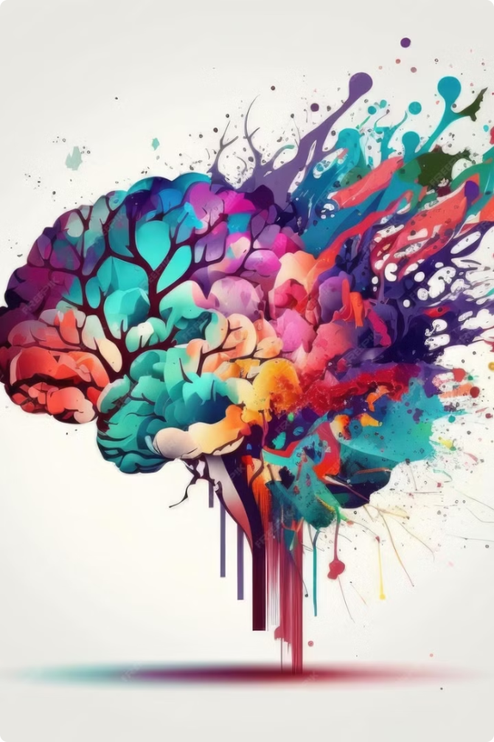
MindGuard: Revolutionizing Digital Mental Health
In today's digital age, children are increasingly vulnerable to mental health challenges. MindGuard+ offers a revolutionary AI-powered solution to address this critical issue. MindGuard+ empowers educators, parents, and mental health professionals with the tools they need to support the well-being of young people in the digital world.

Slide 3
The Growing Need for MindGuard
Mental Health Crisis
Early Detection is Key
MindGuard+'s Solution
Children face a growing mental health crisis with increasing rates of anxiety and depression. Mental health challenges are on the rise for children and adolescents, affecting their overall well-being and academic performance.
Early detection of mental health issues is crucial for timely intervention and improved outcomes. Early intervention is essential for preventing these challenges from escalating and leading to more serious issues.
MindGuard+ offers a privacy-focused, AI-powered solution for real-time behavioral monitoring. By identifying potential mental health risks early, MindGuard+ helps ensure that children receive the support they need.

Slide 4

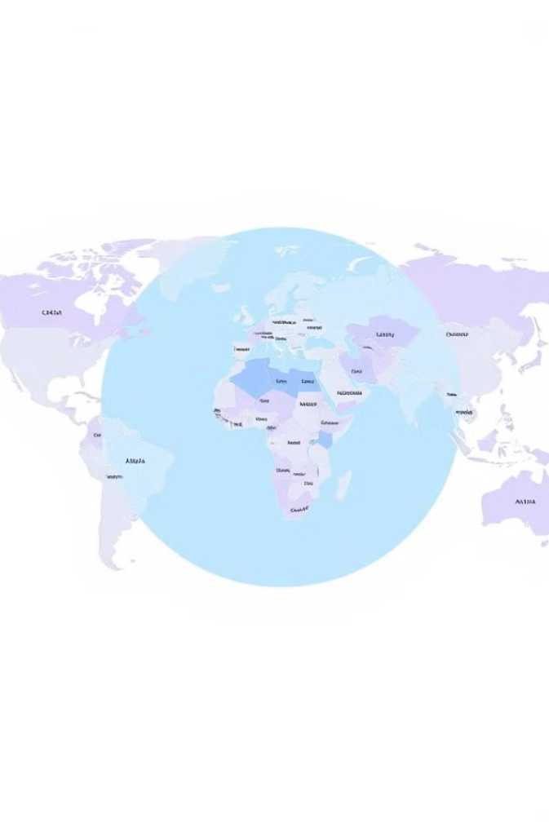
Reaching the Target Audience
Children (10-18 years) are primary users, facing the most significant risks. MindGuard+ focuses on this age group, which is most vulnerable to the negative impacts of technology.
Schools, parents, and mental health professionals are key stakeholders in the system. These individuals play vital roles in a child's life and can leverage MindGuard+ to provide the necessary support.
The market is ripe for AI-driven solutions as demand for mental health support grows. The demand for mental health services is increasing, and MindGuard+ offers a cutting-edge solution for addressing this need.

Slide 5
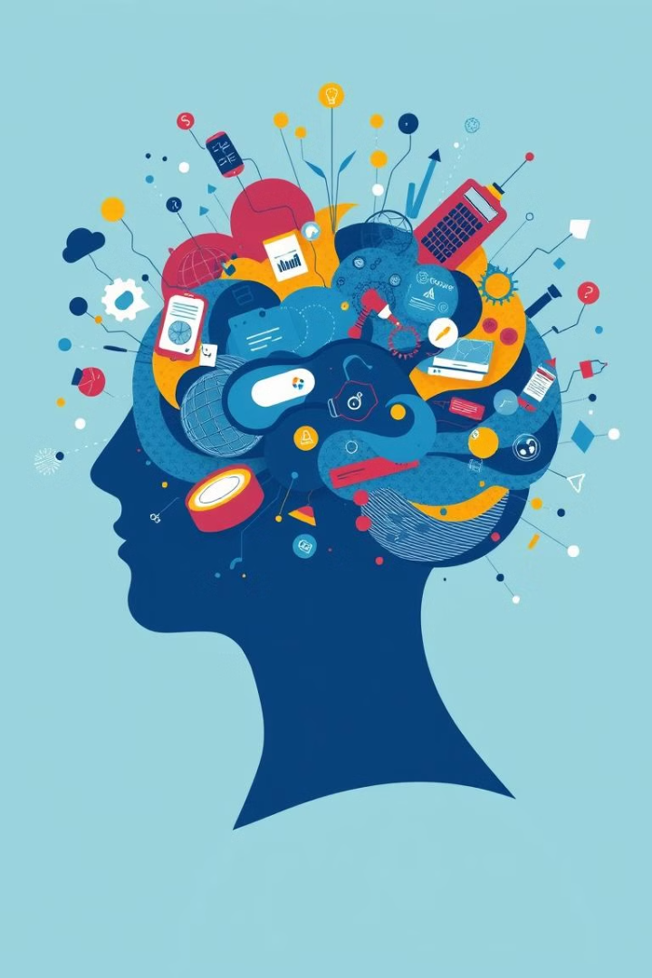



How MindGuard Works
MindGuard+ uses advanced AI to analyze search queries, social media interactions, and digital patterns.
The AI assigns risk scores and alerts parents, schools, and mental health professionals to potential issues.
A dedicated chatbot provides emotional support, mindfulness exercises, and counseling for users.

Slide 6

Scaling MindGuard for Impact
1
Phase 1: Pilot implementation in schools and healthcare institutions. MindGuard+ will be piloted in select schools and healthcare institutions to ensure effectiveness.
2
Phase 2: Expansion to government-backed mental health programs. MindGuard+ will be made available through government-funded mental health initiatives to reach a wider audience.
3
Phase 3: Global partnerships for AI-driven mental health solutions. MindGuard+ will be made accessible to a global audience through partnerships with mental health organizations.

Slide 7


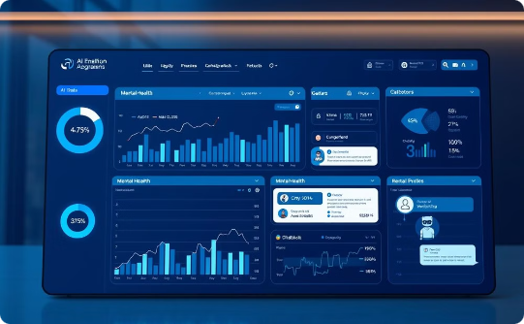
Design Guidelines
Modern, professional layout that reflects the tech + healthcare themes.
Soothing blue, green, and purple colors represent mental wellness and calm.
Icons and visuals depict AI-driven monitoring, mental health awareness, and chatbot interactions.

Slide 8

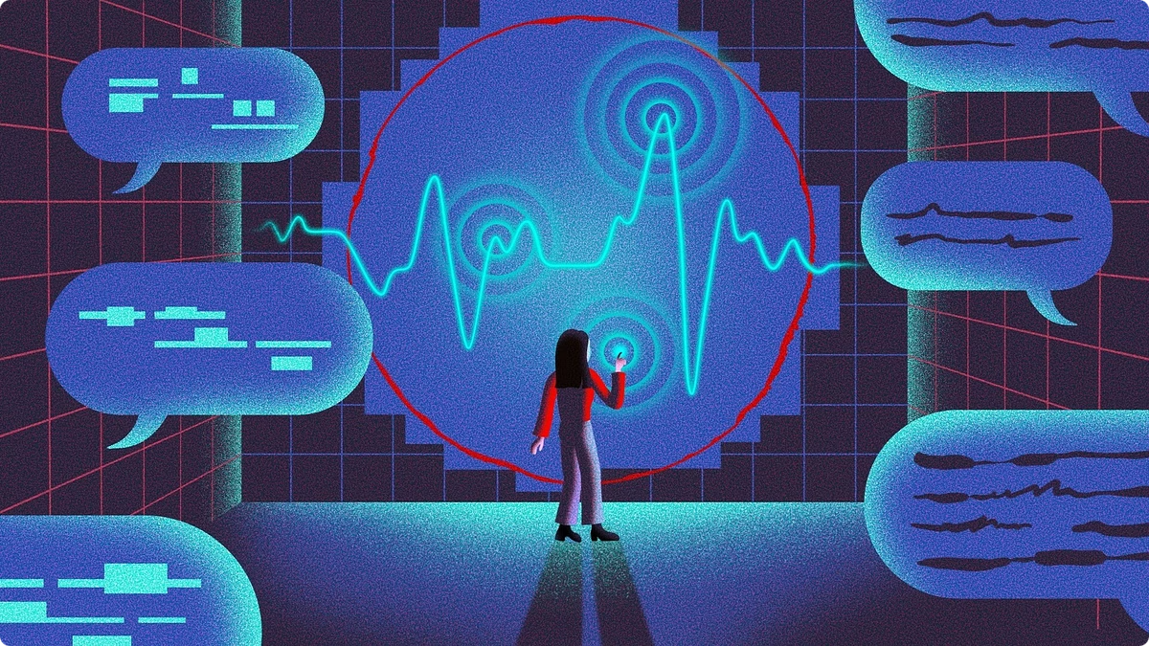
Join the MindGuard Revolution
MindGuard is more than just a technology; it's a commitment to protecting the mental well-being of our youth. MindGuard+ provides a crucial layer of support for our children in the digital age, empowering them to thrive and reach their full potential. Join us in revolutionizing digital mental health protection!

